Slide 1
SDL Tridion Presentation Frameworks
DD4T, DXA & MVC
John Winter
j.winter@contentbloom.com
@wntr

Slide 2
Overview
We’re going to take a high-level look at:
Content & Presentation
Tridion Publishing Models
DD4T
DXA
Note: this isn’t a hard-core techy presentation

Slide 3
Terms in this presentation
Content
Text, images, video, documents
Presentation
Layout and design for web, mobile, print
MVC (model, view, controller)
A modern software architecture for implementing interfaces
Publishing
Making Content and Presentation available to your audience

Slide 4
Content and Presentation

Slide 5
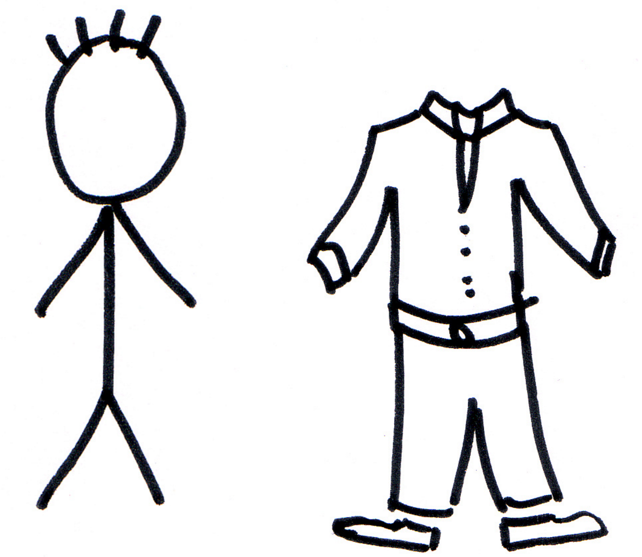
Content and Presentation
Content
Presentation

Slide 6
SDL Tridion Publishing Models

Slide 7
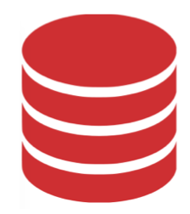
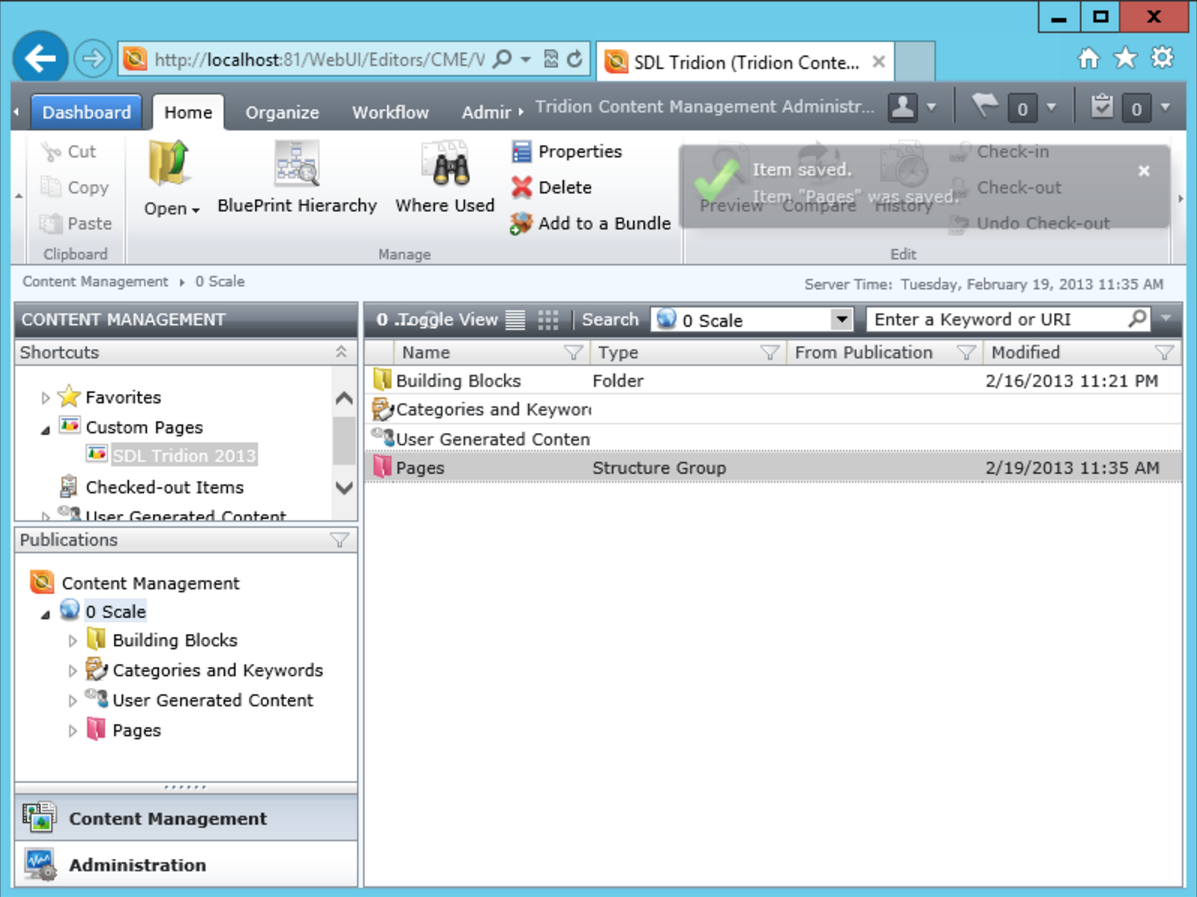
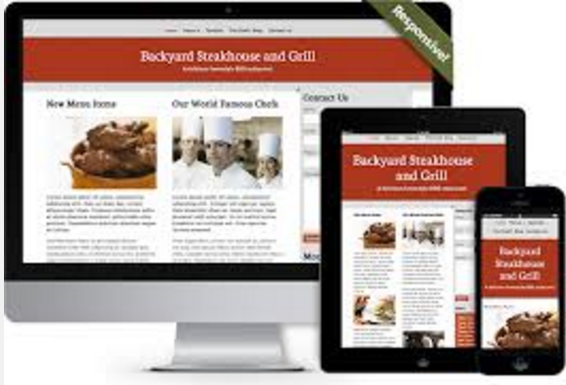

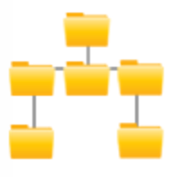
Tridion Publishing Diagram
SDL Tridion
Database
Publish
Web / Mobile / Apps
Deployer
File System

Slide 8
Tridion Publishing Types
Static Publishing
Content and Presentation are together in the CMS
Presentation changes uploaded into CMS and published
Dynamic Publishing
Only Content is the CMS
Content is published in a data format (xml, json) to a database (the broker)
Presentation is managed by end application

Slide 9
DXA & DD4T
Share a lot of similarities:
MVC Frameworks
Available in .Net & Java
Use the SDL Tridion Dynamic Publishing model
Make it easy for new SDL Tridion developers to learn the CMS
Open Source
Both start with the letter D !

Slide 10
DD4T & DXA Architecture
SDL Tridion
DD4T Templates
DXA Install
Database
Content
Only
DD4T MVC App
DXA Web App
Presentation
Deployer
File System

Slide 11
DD4T
(Dynamic Delivery 4 Tridion)

Slide 12
DD4T
Built by the SDL Tridion community
A set of templates to install in Tridion
Publishes content as XML data
An MVC web application:
Extracts content from the Broker Database
Builds Pages and Component Presentation “Models” from this data
Applies “Views” for layout
Some basic SDL functionality:
Resize images
Data Caching
SmartTarget & XPM libraries
Barebones implementation

Slide 13
DXA
(Digital Experience Accelerator)

Slide 14
DXA
Built by and supported by SDL
Under the hood, it uses the DD4T framework
OOTB website plus functionality:
XPM Ready, Navigation, RESS, SEO, Responsive
Modules:
Search, ECL, Analytics, Media Manager

Slide 15


DXA vs. DD4T
The DD4T Burger
The DXA Burger
Great for fresh start applications
Need to built key functionality & presentation
No module support
Website-in-a-box
Re-skin for your needs
Module support
Take out / swap elements you don’t need
SDL Supported

Slide 16
Thanks!
Any questions?
Contact me:
John Winter
j.winter@contentbloom.com
@wntr
832 202 4508

Slide 17
About Content Bloom
Offices in USA, Canada & Europe
Certified SDL Tridion consultancy and partner
Strong knowledge and deep roots within the SDL Tridion product suite
Over 35 successful implementations

